Slide 1
Adding participants
Subtitle

Slide 2
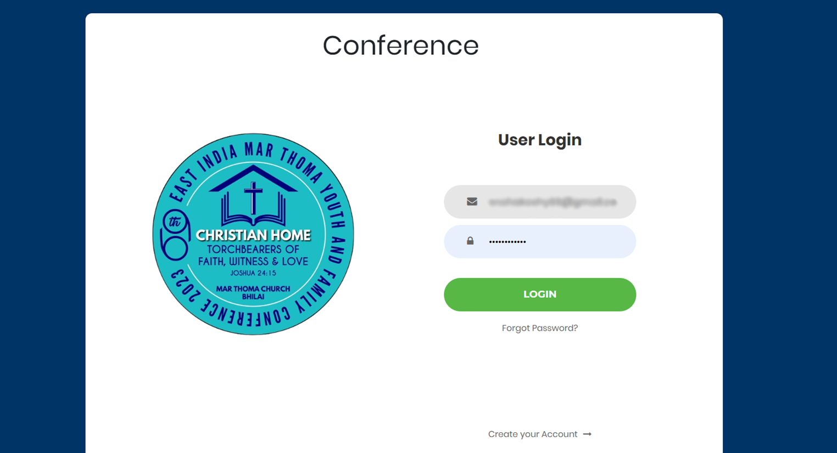
Login using the registered e- mail id and password

Slide 3
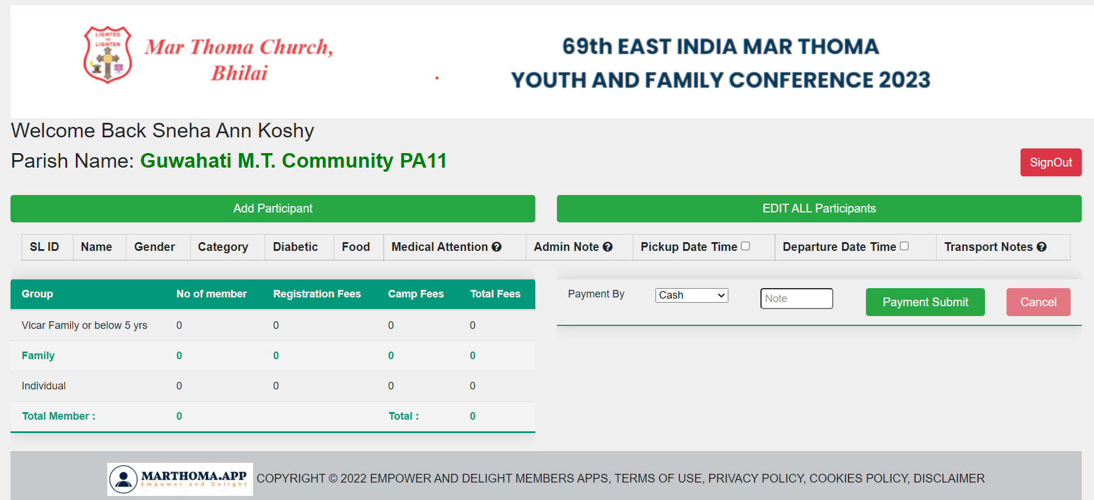
The registration form opens.

Slide 4
Click the Add Participant

Slide 5
From the drop down select which ever category applies
Then select “ Add”

Slide 6
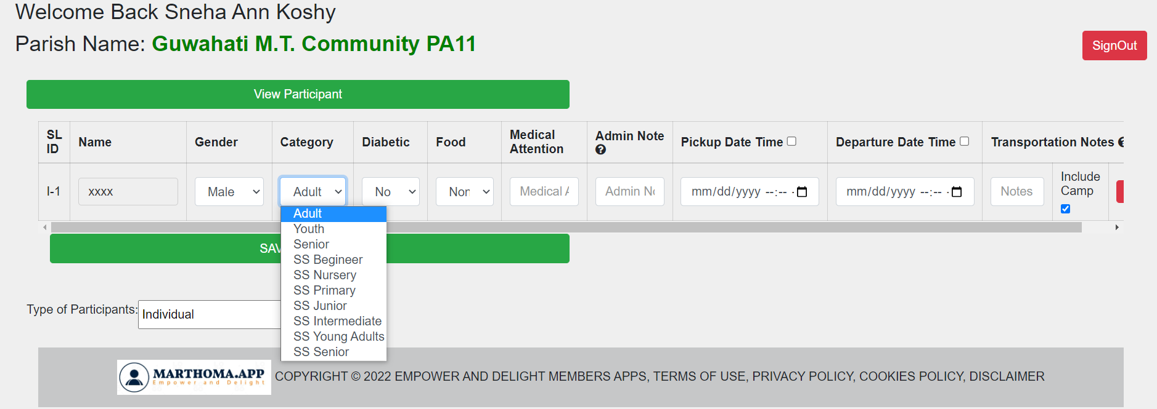
After the name and gender, Select the category (SS- Sunday School, for Sunday school students)
Select the option from the drop down

Slide 7
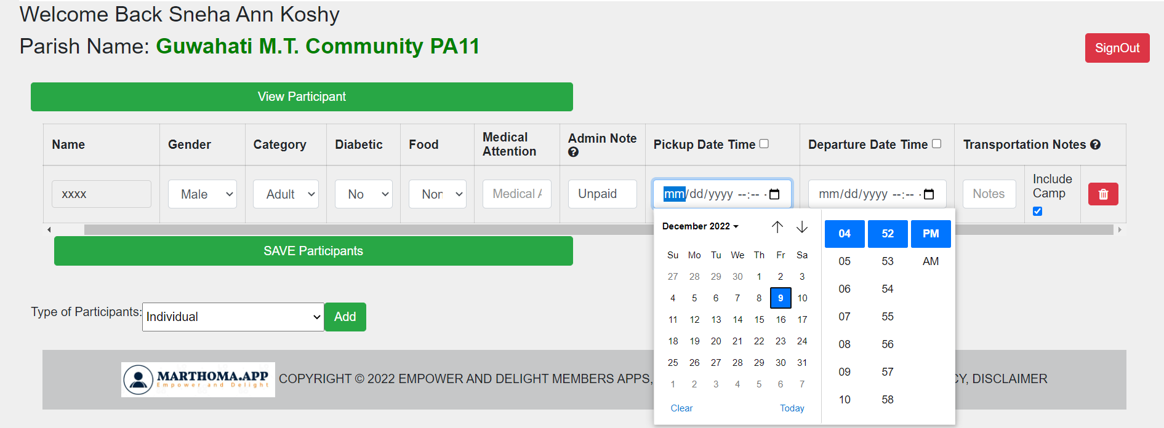
Admin note, please mention the payment status. Unpaid or Paid.
Select time and date of arrival and departure

Slide 8
Please provide Arrival train number and other details.

Slide 9
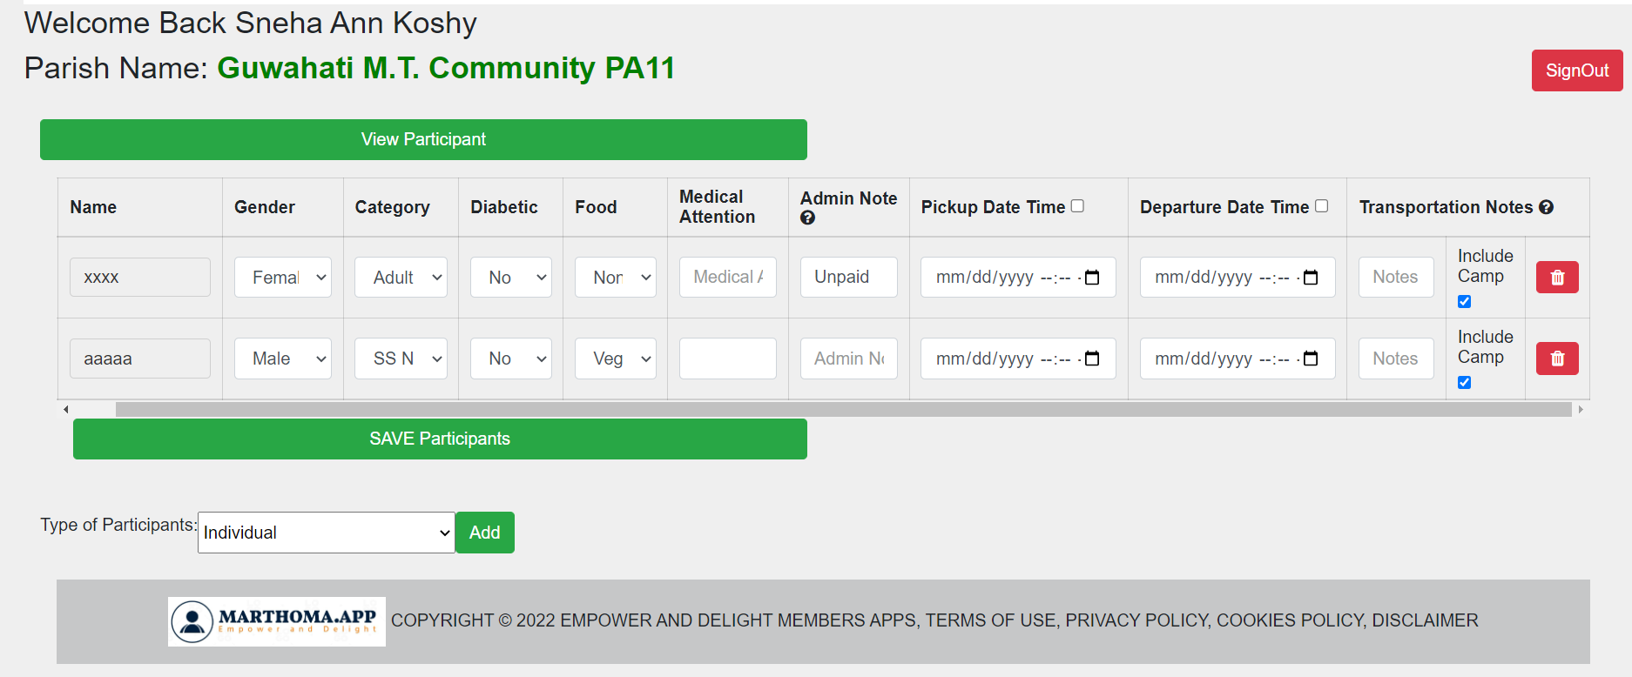
Tap on ‘Add’ to get the next participant
Select this icon to delete any participants

Slide 10
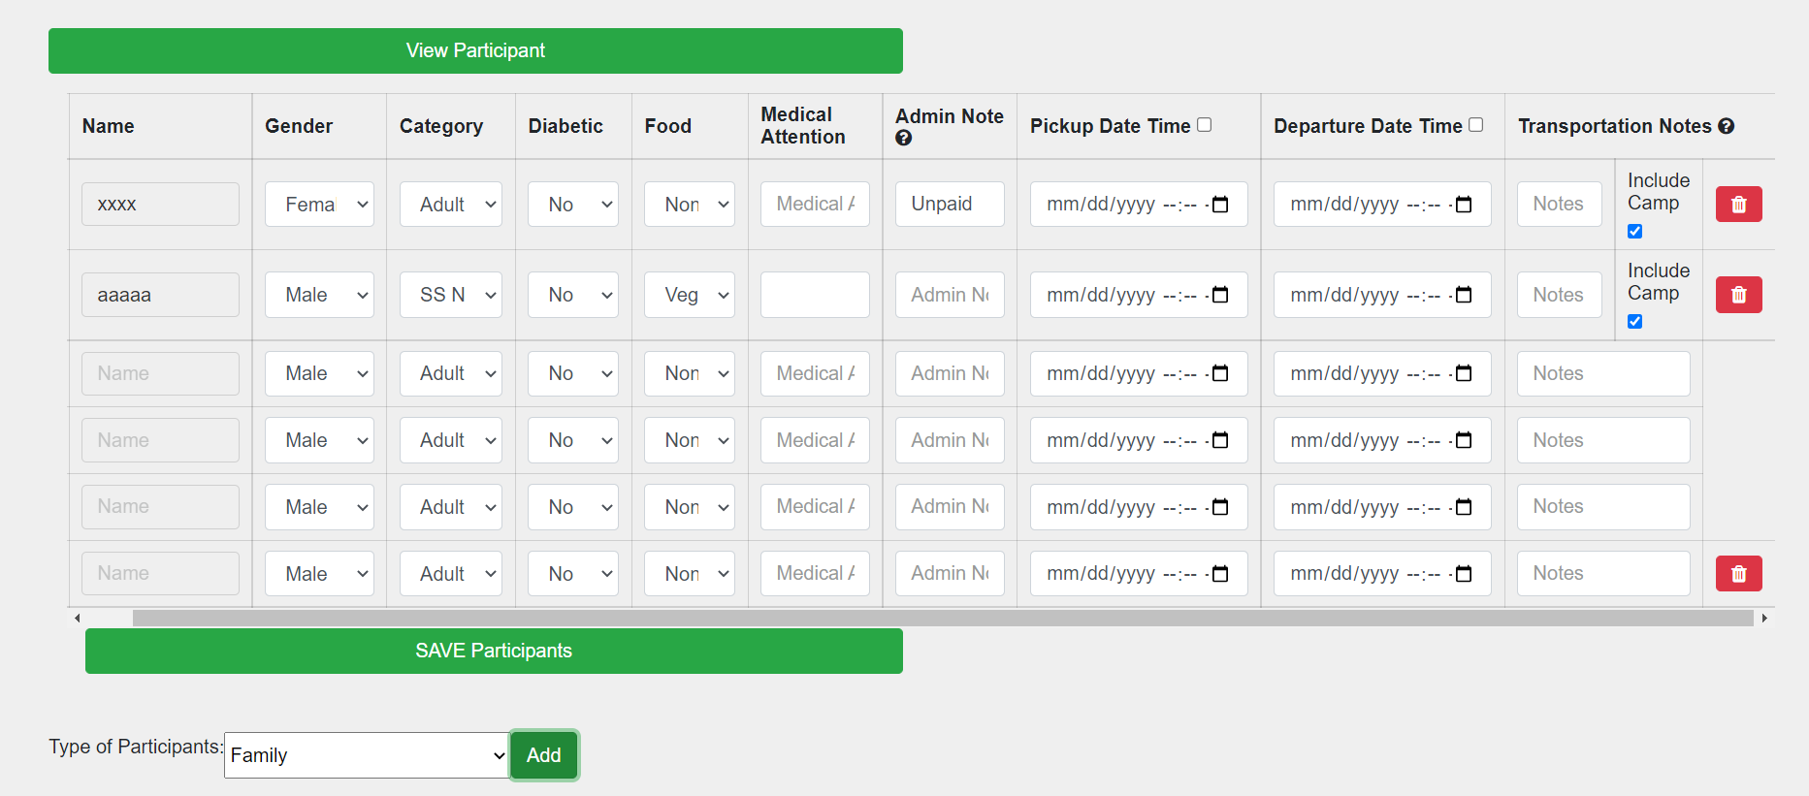
Selecting ‘Family’, brings 4 fields together.

Slide 11
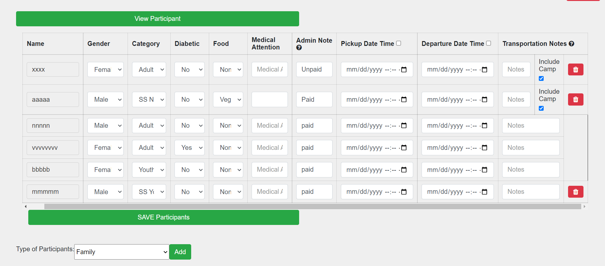
Select ‘SAVE Participants’.

Slide 12
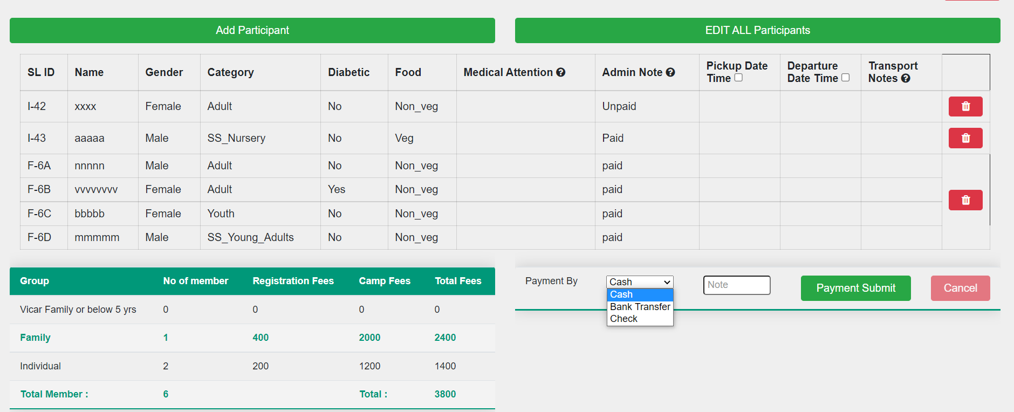
Select the payment method

Slide 13
Tap this icon when all the entries are finalized

Slide 14
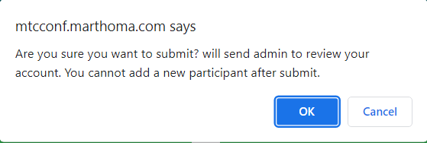
Such a dialog box will pop up

Slide 15
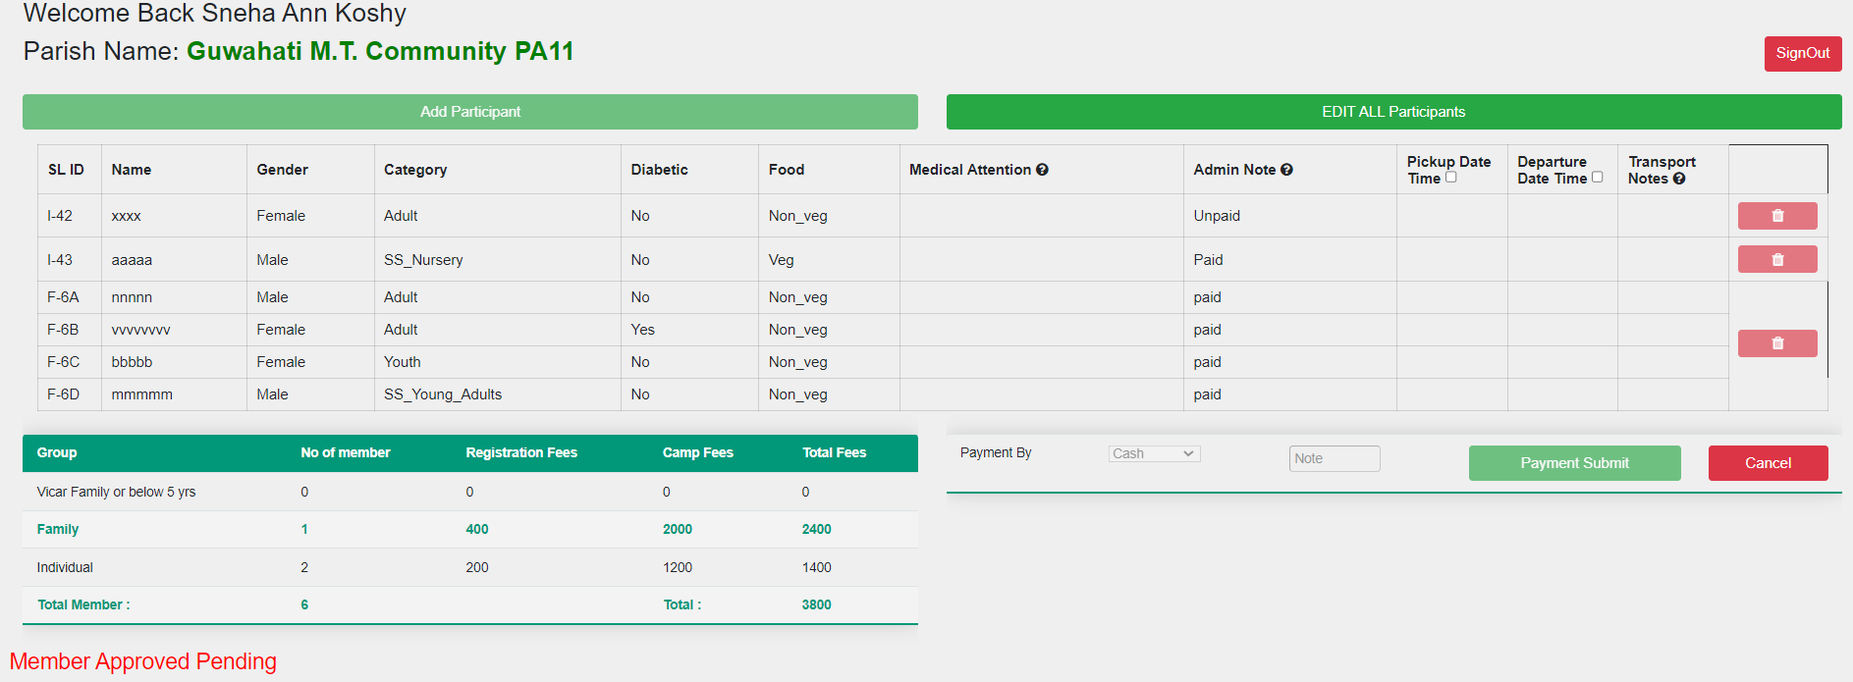
And that’s it!!

Slide 16
Congratulation You have successfully enrolled your parish members
For further quires please contact Mr. Koshy Cheriyan- 8109013609

Slide 17
Add a Slide Title - 1

