Slide 1
Account Creation
Registration form mtfc23

Slide 2
Click on
‘Create your account’

Slide 3
Select your parish
from the drop down
Put in your Name
A valid email ID
Password
Click “Register”

Slide 4
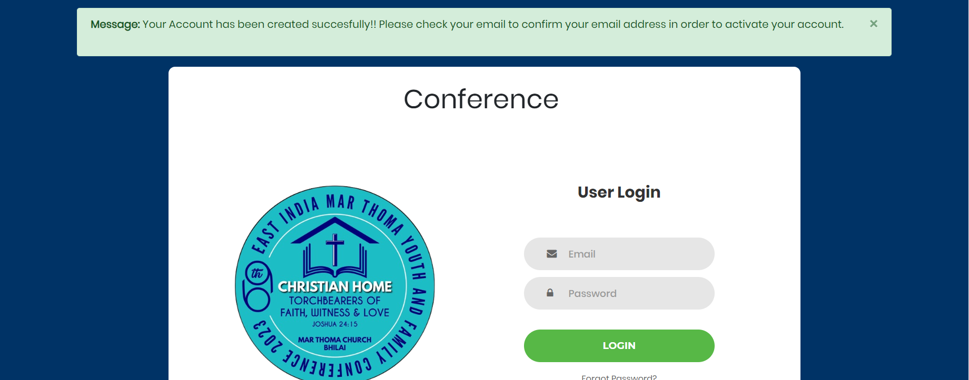
You will be redirected to the login page with this message
Open the registered e- mail ID

Slide 5
Open the registered E- mail ID Check the spam or promotional folder for the conformation email.
On selecting the email, click on the link visible, which will take you to the used login page

Slide 6
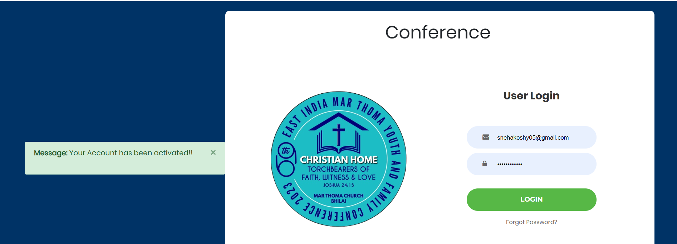
Such a message will be visible, then you can proceed with entering you registered email ID and password
Click “Login” to proceed.

Slide 7
Congratulation You have successfully created you account
For further quires please contact Mr. Koshy Cheriyan- 8109013609

